Slide 1
- CHAPTER NINE-
HEAT EXCHANGER

Slide 2
Some typical examples of heat exchanger applications are:
(i) Thermal power plants (boilers, superheaters, steam condensers, etc.)
(ii) Chemical process industry (variety of heat exchangers between different types of fluids, in reactors)
(iii) Refrigeration and air-conditioning (evaporators, condensers, coolers)
(iv) Automobile industry (radiators, all engine cooling and fuel cooling arrangements)
(v) Cryogenic industry
(vi) Research

Slide 3
Types of Heat Exchangers
Heat exchangers may be classified in several ways:
(i) According to heat exchange process
(ii) According to relative direction of flow of hot and cold fluids
(iii) According to constructional features, compactness, etc.
(iv) According to the state of the fluid in the heat exchanger.

Slide 4
Classification according to heat exchange process:
Heat exchangers may be of 'direct contact type' or 'indirect contact type'
Classification according to relative direction of hot and cold fluids:
parallel flow'
counter-flow'
cross flow'
Classification according to constructional features:
Basically, there are three types: (a) concentric tubes type (b) shell and tube type, and (c) compact heat exchangers
Classification according to state of the fluid
Condenser
Evaporator.

Slide 5
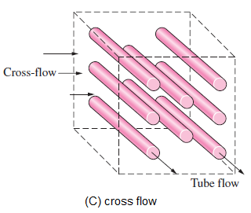

Slide 7
THE OVERALL HEAT TRANSFER COEFFICIENT
A heat exchanger typically involves two flowing fluids separated by a solid wall. Heat is first transferred from the hot fluid to the wall by convection, through the wall by conduction, and from the wall to the cold fluid again by convection. The thermal resistance network associated with this heat transfer process involves two convection and one conduction resistances, as shown in Figure 3.
$$R=R_{tot}=R_{i}+R_{wall}+R_{o}=\frac{1}{h_{i}A_{i}}+\frac{ln⁡({D_{o}}/{D_{i}})}{2πkL}+\frac{1}{h_{o}A_{o}}$$
$$Q=\frac{∆T}{R}=UA∆T$$
Where U is the overall heat transfer coefficient, whose unit is W/m²°C. Which is identical to the unit of the convection coefficient h. canceling $∆T$ the Eq. reduces to

Slide 8
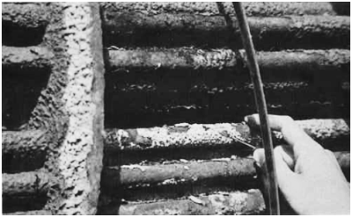
Fouling factors
Note that: above analysis was for clean heat transfer surfaces. However, with passage of time, the surfaces become 'dirty' because of scaling, deposits, corrosion, etc. This results in a reduction in heat transfer coefficient since the scale offers a thermal resistance to heat transfer. Fouling may be categorized as follows:
(i) Due to scaling or precipitation.
(ii) Due to deposits of divided particulates.
(iii) Due to chemical reaction.
(iv) Due to corrosion.
(v) Due to attachments of algae or other biological materials.
(vi) Due to crystallization on the surface by subcooling.

Slide 9
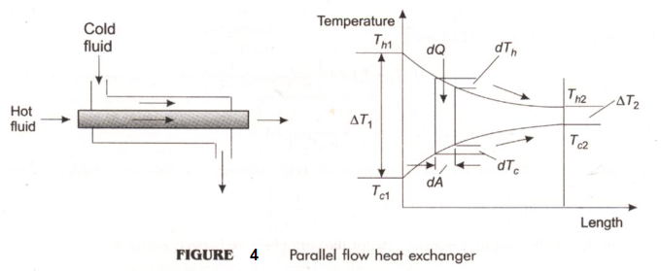
The LMTD Method for Heat Exchanger Analysis
$$∆T_{m}=\frac{\left(T_{h2}−T_{c2}\right)−\left(T_{h1}−T_{c1}\right)}{ln\left[\frac{T_{h2}−T_{c2}}{T_{h1}−T_{c1}}\right]}$$

